Slide 1
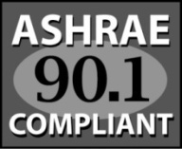




Engineering Principles
Heating & Ventilating with 100% Outside Air

Slide 2

Introductions
Dave Binz
  Cambridge Engineering
  Director of Engineering
  Chesterfield, MO

Slide 3
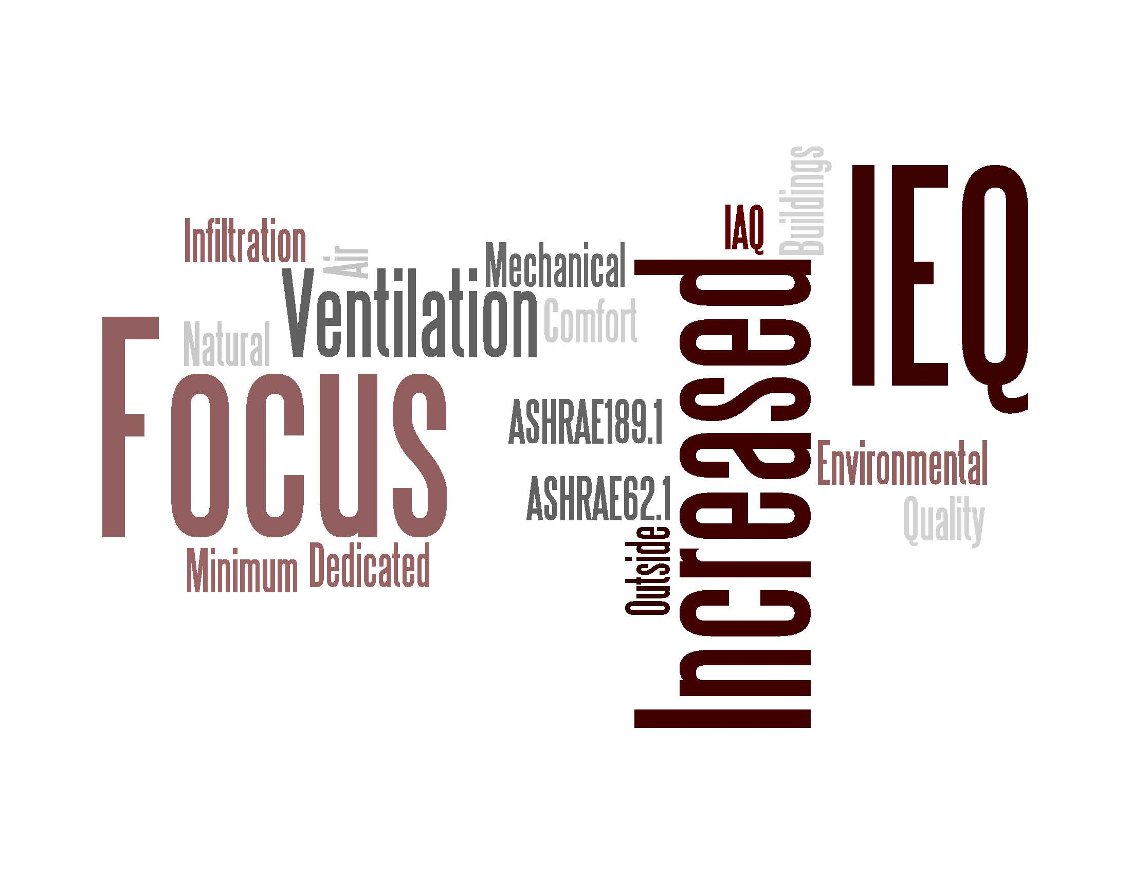
Two Trends
Trend #1 - Ventilation

Slide 4
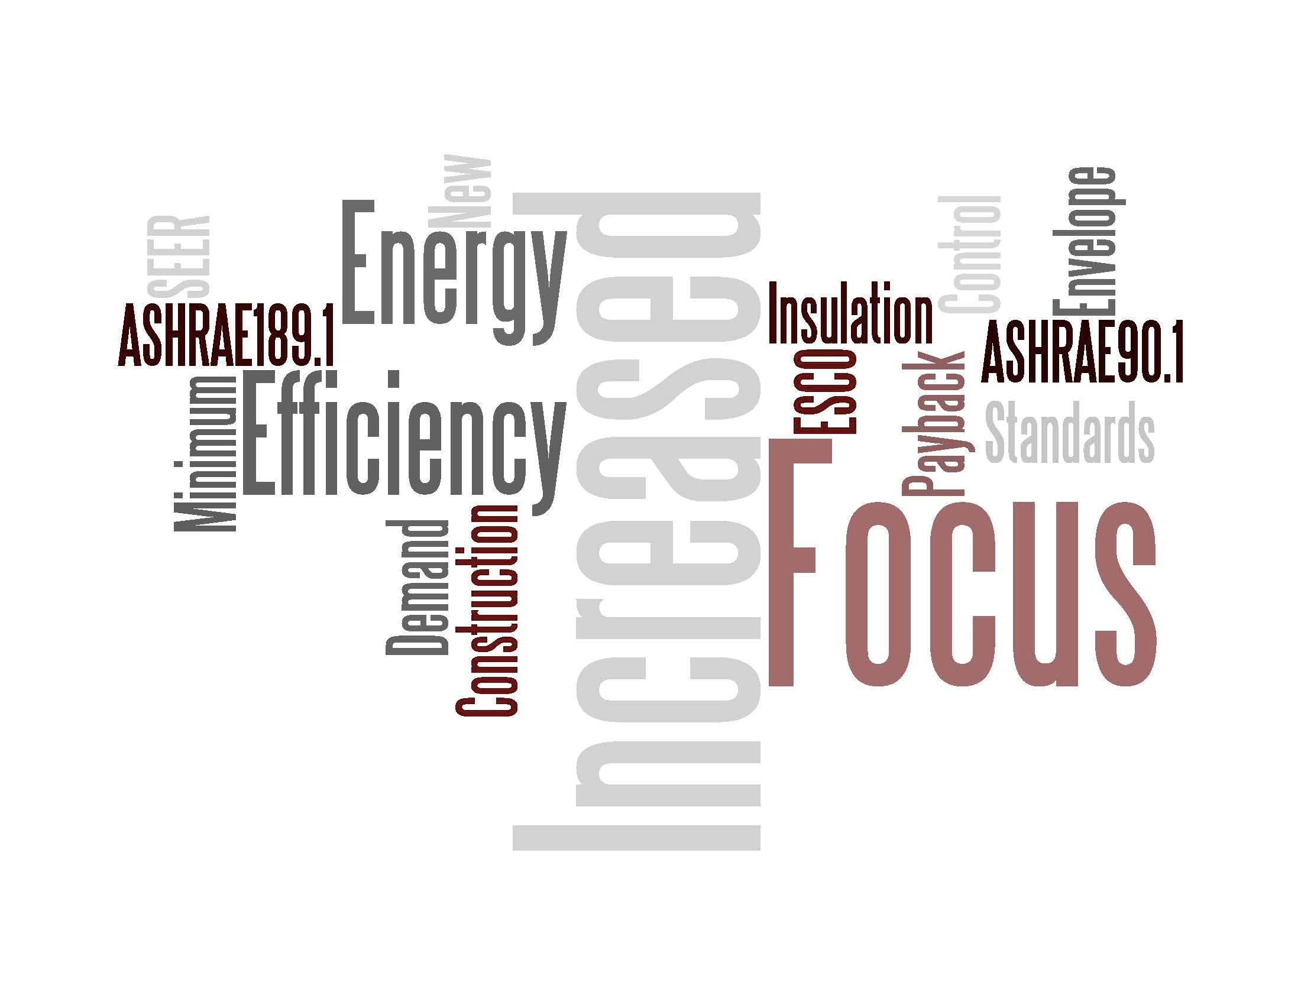
Two Trends
Trend #2 - Energy

Slide 5

Two Trends

Slide 6
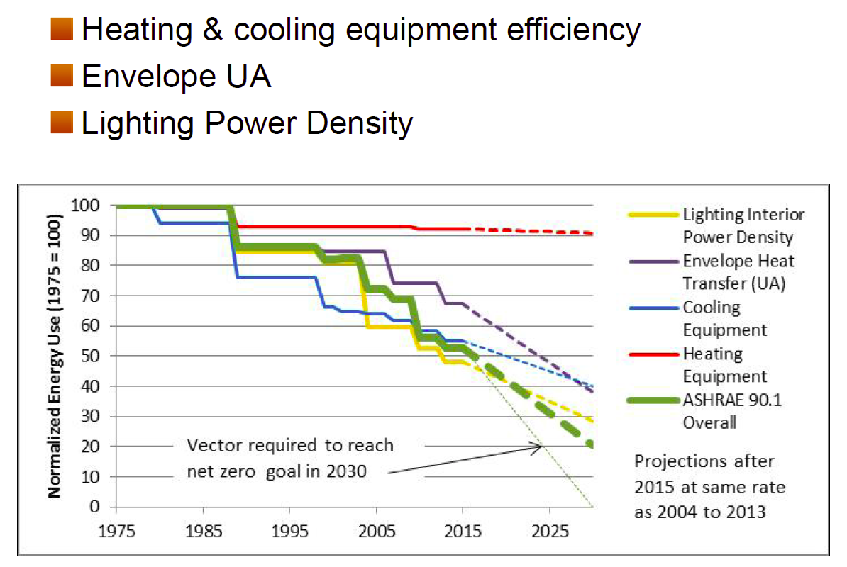
Why Focus on Heating Systems?
25 Years
Lighting – 44% Improvement
Envelope – 21% Improvement
Desired Line
Cooling – 27% Improvement
Heating – 1% Improvement
Overall – 37% Improvement
Source: End Use Opportunity Analysis from Progress Indicator Results for ASHRAE Standard 90.1-2013
Pacific Northwest National Laboratory

Slide 7
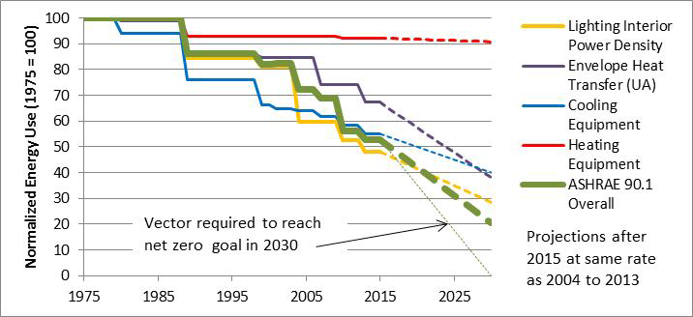
Energy Savings Goal
To reach the energy savings goals for the whole building, heating system efficiency must improve
How can we utilize today’s technology to improve heating system efficiency?
Rosenberg et al. 2015. “Roadmap for the Future of Commercial Energy Codes.” Pacific Northwest National Laboratory. January 2015.

Slide 8
Session Objectives
At the end of the session, we will be able to:
Understand how a building can meet its space heating and ventilation needs through 100% outside air direct fired heating technology
Understand the differences between draw through (MAU) and blow through (HTHV) technologies
Understand the inherently safe design of MAU & HTHV direct-fired, heating and ventilation technologies with focus on ventilation
Understand the engineering calculations behind delivering the most btus/cfm or the most energy efficient way to heat a building
Understand how one might engage Cambridge Engineering, Inc. team to support your valuable work with your clients

Slide 9




Cambridge Engineering, Inc.
A Leader in Energy Efficient Heating & Ventilation Technologies

Slide 10
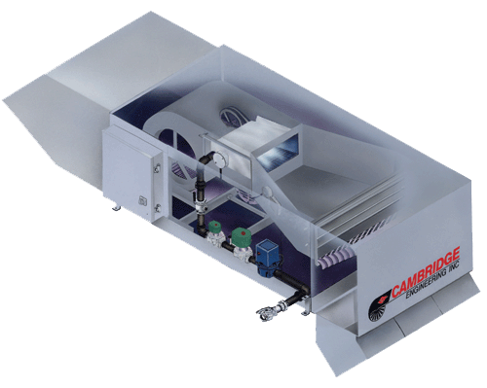
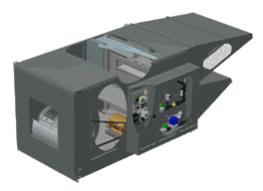
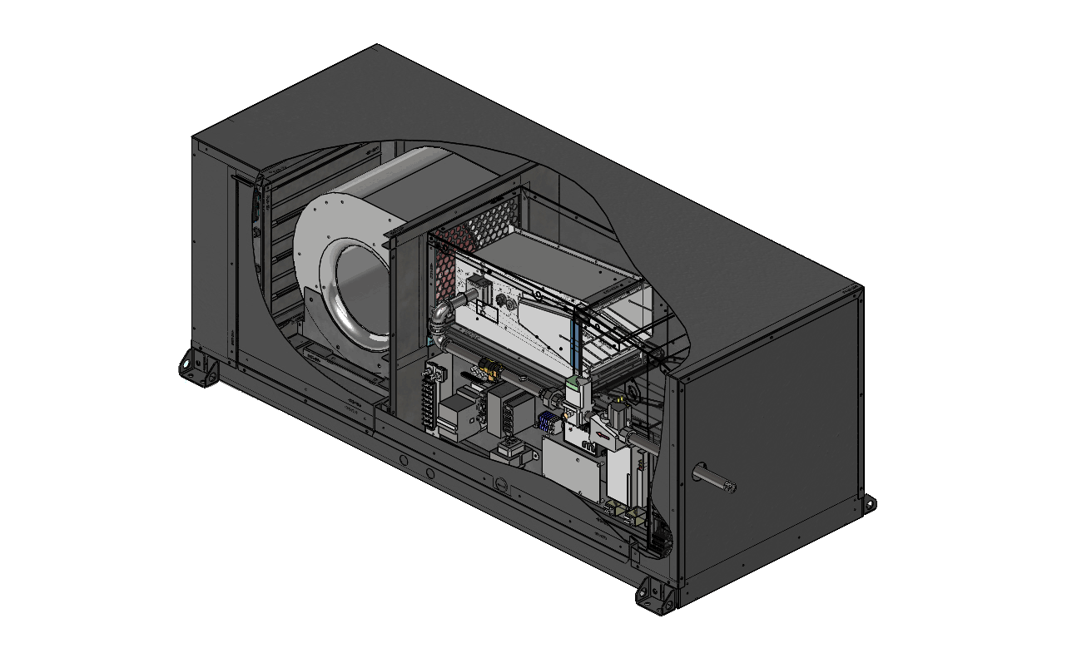
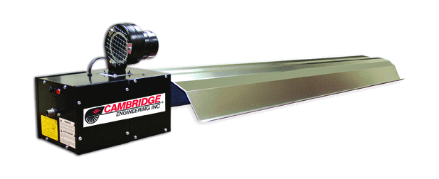
CAMBRIDGE Product Lines
S-Series – Blow Thru
HTHV
400-3200 MBH
M-Series – Draw Thru
Make Up Air
1800-75000 CFM
SA-Series – Blow Thru
HTHV
250-350 MBH
ITH - Infrared

Slide 11
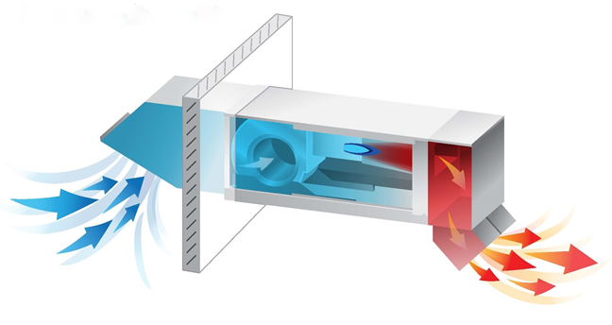
What is HTHV?
High-Temperature Heating & Ventilation units
  100% Outside Air, Direct-Fired Heater
  Greater than 140 degree temp rise
  Greater than 150 degree discharge temp
  Fully Modulating Temperature Controls to meet both ventilation & space heating requirements

Slide 12
History of HTHV:
100% OA Direct Fired Technologies
CEI introduced “S” line in 1990’s
160°F discharge temperature achieved
Transformed heat only, non-ducted market (Warehouse/Distribution/Manufacturing)
Reason #1
40% Lower Install $
Reason #2
40-70% Less Energy
Reason #3
Free Ventilation (IEQ)

Slide 13
Key HTHV Education Statements
Energy Efficiency
Inherent Safety (IAQ)
Simplicity of Design

Slide 14
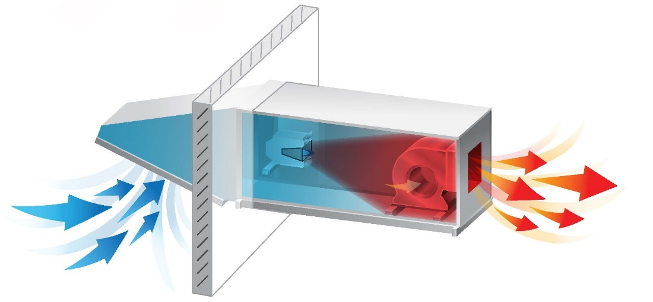

100% OA Direct Fired
No Heat Exchanger - No Flue Losses - 92% thermal /100% combustion Efficient
MAU / (Draw Thru)
Blower in hot air stream
120°F max discharge
Are these safe?
HTHV / (Blow Thru®)
Blower in cold air stream
160°F max discharge

Slide 15
Inherently Safer Design (ISD)
ANSI Z83.4
ANSI Z-83.4 – Unified Canadian/US Safety standard for 100% OA Direct Gas-Fired Air Heaters
  Max CO less than 5ppm
Allows ASHRAE 62.1 minimum ventilation for acceptable indoor air quality compliance
95+% of kitchen make-up air systems
CSA Certified Clean Combustion
Zero Clearance to Combustibles

Slide 16
CDC Report on CO Poisoning
“Unintentional CO exposure accounts for an estimated 15,000 emergency room visits and 500 unintentional deaths in the United States each year.”
CAUSES
  Automobile Exhaust 67%
  Home Heating (Indirect Fired) 33%
  Direct Fired 100% OA (ANZI Z83.4) 0, NADA
WHY?

Slide 17
CDC Report on CO Poisoning
“Unintentional CO exposure accounts for an estimated 15,000 emergency room visits and 500 unintentional deaths in the United States each year.”
What is the single root cause for each of the 500 deaths
Lack of adequate ventilation
ANSI Z-83.4 – Engineered technology to provide adequate ventilation to protect against these types of exposures.

Slide 18
What Insures Adequate Ventilation?
Redundant Engineering Controls
  Air Flow Pressure Switch
  High Limit Switch
  Temperature Control System
FMEA (Failure Mode Effects Analysis)
  Removed all three controls
  Block Airflow
  Result – Highest CO Level Measured at 10 ppm
Combustion air and Ventilation air are delivered by same blower attached to 100% OA – Cannot Separate

Slide 19
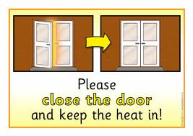

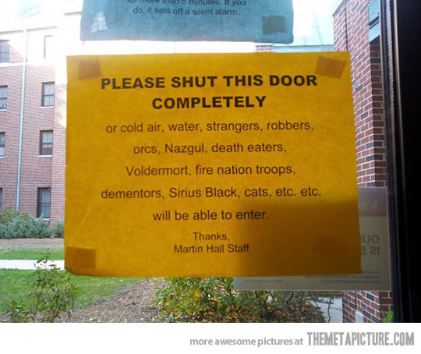
How Can It Be Efficient To Use Outside Air To Heat?

Slide 20
Outside Air Compliance
Every building requires outside air for human occupancy - ASHRAE 62.1/62.2
Every building must get this air from either mechanical ventilation or natural infiltration.
Air load is significant portion of heat load (30-70% with balance being conduction losses)

Slide 21
How Do You Heat This Air Load?
Indirect Fired
Direct Fired
60%-83% AFUE
Flue Losses
92%-100% AFUE
No Flue Losses
100% OA Make Up Air
Who knows the most energy efficient way to heat the air load?

Slide 22


Ventilation Only System
869 MBH Output
70°F Discharge (LT)
Low Velocity (LV)
10,000 cfm
0°Inlet Air
No Heat Exchanger
No Flue Losses
92%/100% Efficient
Energy Efficient for Air Load and Most Competitive 1st Cost

Slide 23
How Do You Heat The Conduction Load?
Add Indirect Fired System
  60%-83% AFUE
  Flue Losses
Turn Up Discharge of 100% OA Direct Fired System
  92%-100% AFUE
  No Flue Losses
  Every Degree Above Space Temperature is Usable for Conduction Losses
Which of these is more energy efficient?
Which of these have lowest 1st cost?

Slide 24
Ventilation Only
869 MBH Output
70°F Discharge (LT)
Low Velocity (LV)
10,000 cfm
0°Inlet Air
High Efficiency Space Heating
1987 MBH Output
160°F Discharge (HT)
High Velocity (HV)
10,000 cfm
0°Inlet Air
Additional 90°F provides 1118 MBH of Usable Btu’s
(Available for Conduction) = 1987 MBH – 869 MBH

Slide 25

The Importance of High Discharge Temperature (HT)
Equipment $$/ Installation $$
Example Design Load
  1118 MBH Conduction Load
Wasted Energy $$
Unit Type | Discharge Temp | Design Temp | Usable BTU’s/10,000 CFM | CFM Required to Cover Conduction Load
Push Thru | 160 | 70 | 1118 MBH | 10,000
Draw Thru | 120 | 70 | 492 MBH | 24,000
Draw Thru | 100 | 70 | 306 MBH | 39,000
Draw Thru | 70 | 70 | 0
Is this efficient?
92%/100% Efficient
100% Outside Air
Direct Fired
Notes:
This HT technology allowed engineers to use one piece of equipment to heat the air load and the conduction load.

Slide 26
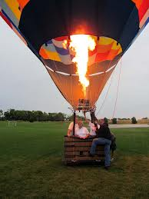

Hot Air Rises
How do we address?

Slide 27
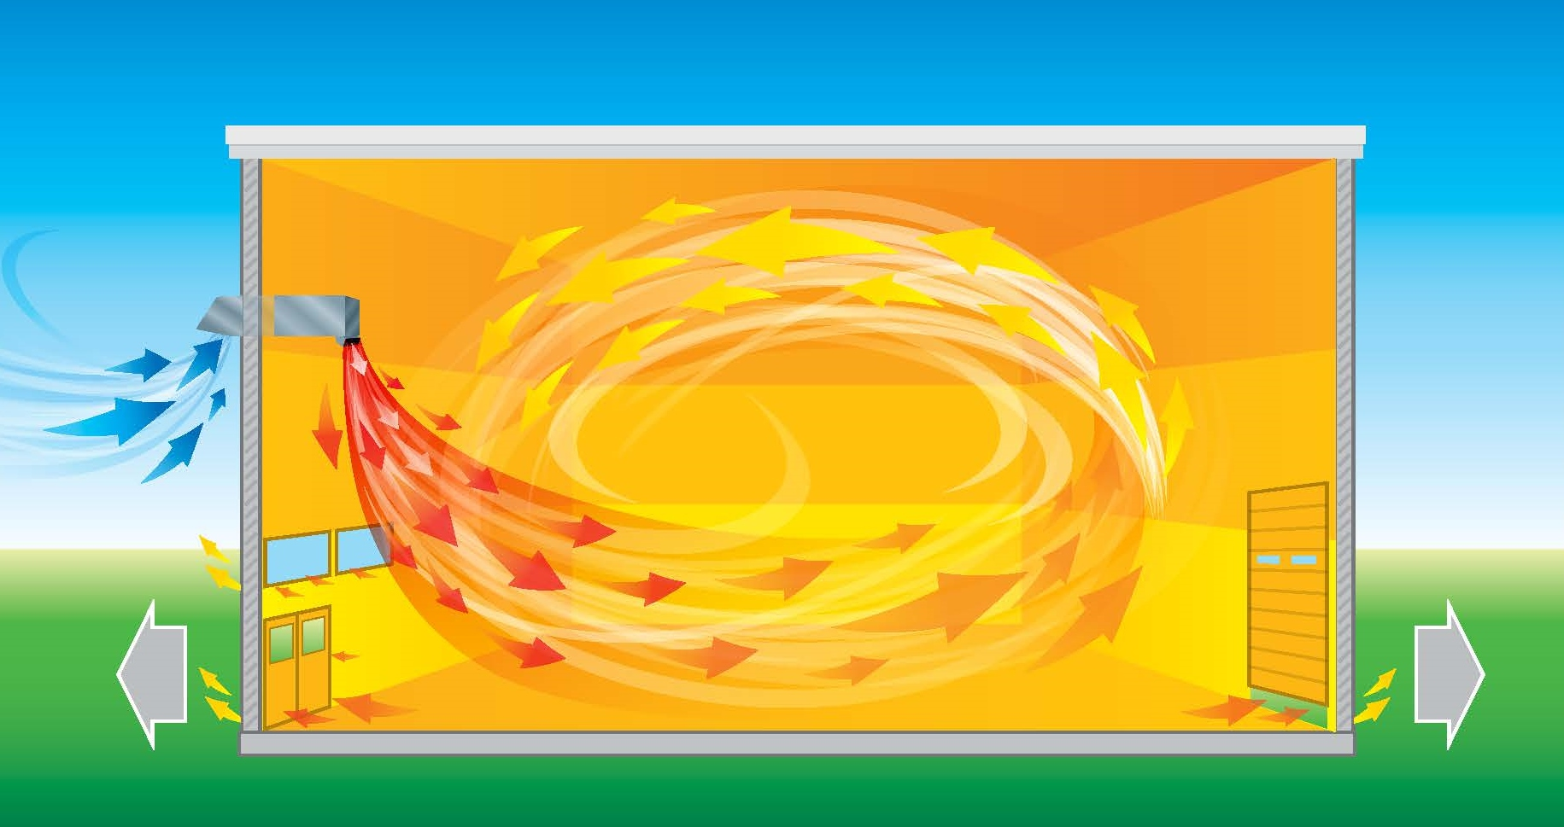


De-stratification Technologies
HVLS Fan/Pear Fans/Zoo Fans
Or
HTHV with Higher Velocity Discharge - 1500 FPM
Sweeps & Induces Stratified Ceiling Heat
10:1
Induction Ratio
Low Velocity
High Volume Air
Notes:
In addition to all of the efficiency, this provides temperature comfort for occupants.

Slide 28
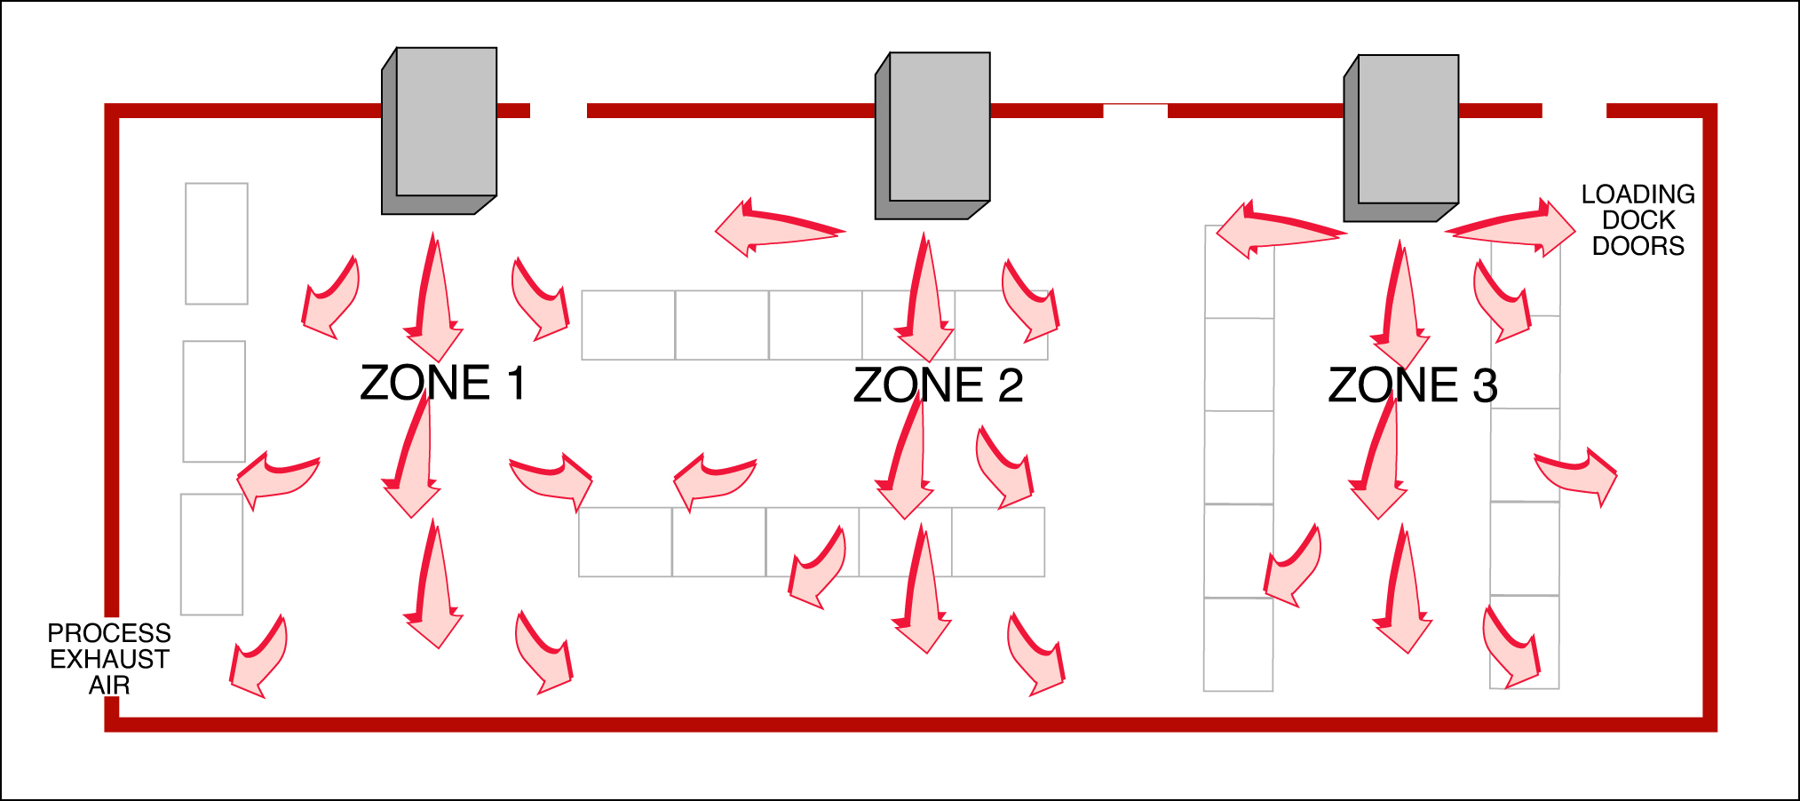
Design Considerations - Distribution
Zone Design
Heaters positioned near greatest air load
Cambridge - Technical Advisor Team

Slide 30
Efficiency & Design Impact
Draw Thru (MAU)
Blower in Hot Air Stream
(M-Series)
Cold Air
Blow Thru® HTHV
(S-Series)
Blower in Cold Air Stream
Cold Air

Slide 31
What is the Difference?
Draw Thru (MAU)
Blow Thru® (HTHV)
Constant Volume Fan
Blower in Hot Air Stream (Less Dense)
Lower Discharge Temperature (120°F)
Lower mass flow rate
Constant Volume Fan
Blower in Cold Air Stream (More Dense)
Higher Discharge Temperature (160°F)
Higher mass flow rate

Slide 32



Convective Heat Transfer
100% direct fired outside air heating systems transfer sensible (dry-bulb) heat from the discharge air entering the building. The total input Btu/h can be expressed as
= Total heat transferred (Btu/h)
= Mass flow of air (lb/h)
= Specific heat of air (.24 Btu/lb/°F)
= Discharge Temp - Outside Temp (°F - both at design)
Why can’t we simply use
1.08 is a Standard Correction Factor and is only valid at Standard Conditions (70F) or with Standard CFM not Fan CFM

Slide 33

Mass Flow Rate
Draw Thru (MAU)
Blow Thru® (HTHV)
Constant Volume Fan
Processing 120°F Air
Density at Fan = .068 lbs/ft³
Constant Volume Fan
Processing 0°F Air
Density at Fan = .086 lbs/ft³
26% More mass per fan CFM
26% More btu/h transferred for every CFM processed by the constant volume fan simply due to density
* Based on 70°F Design at 0°F at Sea Level

Slide 34



Discharge Temp
Pull/Draw Thru
Blow Thru®/Push Thru
Constant Volume Fan
Lower Discharge Temperature (120°F)
Constant Volume Fan
Higher Discharge Temperature (160°F)
33% More btu/h transferred for every CFM processed by the constant volume fan simply due to discharge temperature
* 70°F Space Temp/0F Design at Sea Level

Slide 35
Mass Flow + Discharge Temperature
Draw Thru (MAU)
Blow Thru® (HTHV)
Constant Volume Fan
Lower Mass Flow
Lower Discharge Temperature (120°F)
Constant Volume Fan
Higher Mass Flow (26%)
Higher Discharge Temperature (160°F - 33%)
68% More Btu/h Transferred for Every CFM Processed by the Constant Volume Fan
* 70°F Space Temp/0°F Design at Sea Level

Slide 36
Impact on Conduction Load
Remember how we covered the conduction load?
Turn up discharge of 100% OA direct fired system
  92%-100% AFUE
  No flue losses
  Every degree above space temperature is usable for conduction losses
These are called net btus or usable btus

Slide 37



Discharge Temp
Draw Thru (MAU)
Blow Thru® (HTHV)
Constant Volume Fan
Lower Discharge Temperature (120°F)
Constant Volume Fan
Higher Discharge Temperature (160°F)
80% more usable/net btu/h transferred for every CFM processed by the constant volume fan simply due to discharge temperature
* 70°F Space Temp/0°F Design at Sea Level

Slide 38
Usable BTU Impact Mass Flow + Discharge Temperature
Draw Thru (MAU)
Blow Thru® (HTHV)
Constant Volume Fan
Lower Mass Flow
Lower Discharge Temperature (120°F)
Constant Volume Fan
Higher Mass Flow (26%)
Higher Discharge Temperature (160°F - 80%)
127% More Net Btu/h Transferred for Every CFM Processed by the Constant Volume Fan
* 70°F Space Temp/0°F Design at Sea Level

Slide 39


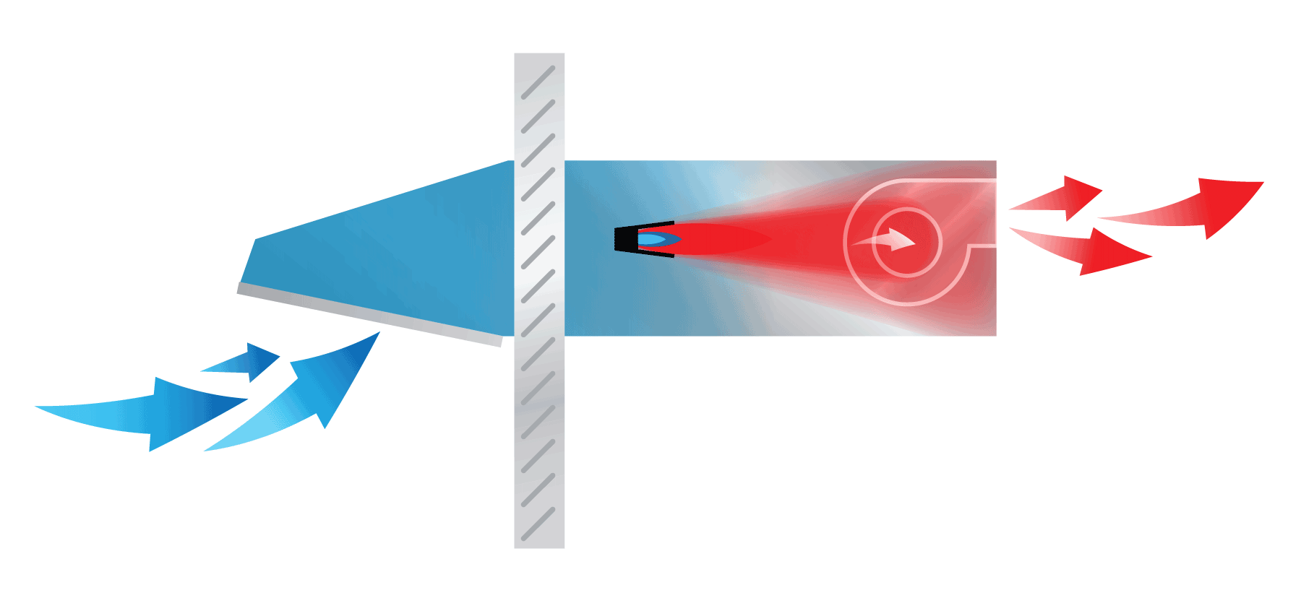
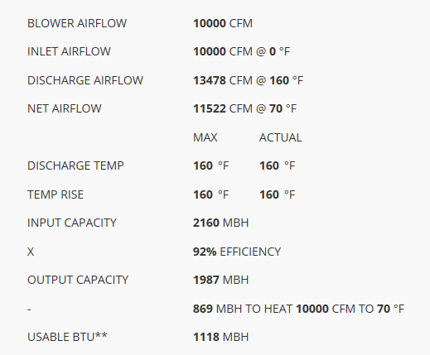
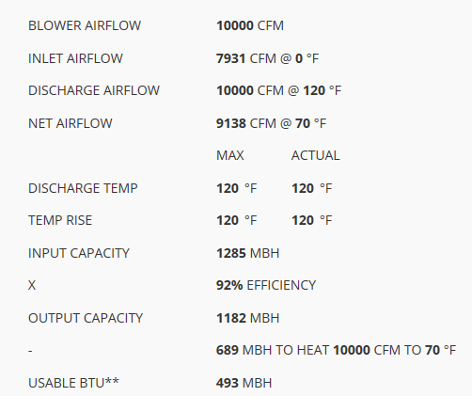
Same Blower Airflow – 10,000 CFM
160°F vs. 120°F Discharge
68% More Output Btu
127% More Usable/Net Btu

Slide 40
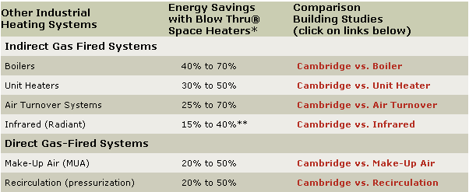
Proven Performance
400+ Energy Building Studies (with Utility Bills)

Slide 41

Retrofit Case Study
HTHV Space Heaters vs.
Unit Heaters
Food Distribution Warehouse
Before – Unit Heaters
Performance
Uneven temperatures
Cold dock areas
High gas costs
Poor Indoor Air Quality
Operating Costs
Based on:
196,918 therms for 2006 -07
heating season
Normalized to 30 year averages
$0.36/ft² Total cost
S3200
S3200
After – HTHV Space Heaters
Performance
More even temperatures
Better Indoor Air Quality
Lower Energy Cost
Operating Costs
Based on:
136,042 therms for 2007-08
heating season
Normalized to 30 year averages
$0.25ft² Total cost
630’
S1200
S950
S950
S1200
880’
Building Specifications
540,700 ft²
Located in Cleveland, OH
61 Dock Doors
Summary
The HTHV system saved 31% in gas while providing better overall temperatures in the building.
The HTHV system saved approximately $59,500/year operating at $0.25/ft² vs. $0.36/ft².
Copyright © 2008 Cambridge Engineering, Inc. • All Rights Reserved
DFR-RS111-0209

Slide 42
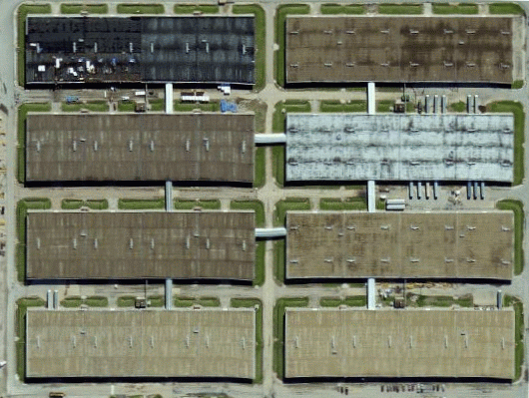
Retrofit Case Study
HTHV Space Heaters vs.
Hot Water Boiler
Before – Hot Water Boiler/Unit Heaters
Performance
Uneven temperatures
Cold draft areas
High maintenance cost
High gas and electric bills
Operating Costs
Based on:
589,793 therms/1,640,667 kWh for 2008
Normalized to 30 year averages
$0.55/ft² Gas cost @ $1.00/therm
$0.14/ft² Electrical cost @ $0.09/kWh
Heavy Equipment Warehouse
After – HTHV Space Heaters
Performance
More even temperatures
Reduced maintenance costs
Red uced gas and electric bills
Operating Costs
Based on:
406,256 therms/267,216 kWh for 2010
Normalized to 30 year averages
$0.38/ft² Gas cost @ $1.00/therm
$0.02/ft² Electrical cost @ $0.09/kWh
Building Specifications
(8) 134,375 ft² buildings
1,075,000 ft² total
24’ high
Concrete walls
Concrete roof w/ 1½” insulation
Located in Delavan, IL
Summary
The HTHV system used 42% less total energy.
The HTHV system saved approximately $312,000/year operating at $0.40/ft² vs $0.69/ft².
Copyright © 2008 Cambridge Engineering, Inc. • All Rights Reserved
DFR-RS111-0209

Slide 43
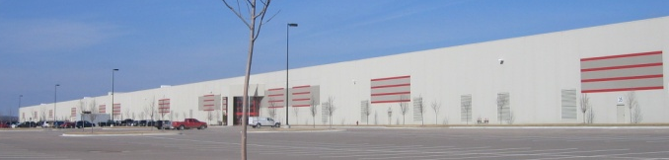
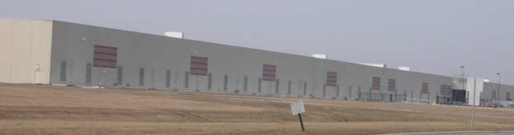
Comparative Case Study
Performance
HTHV Space Heaters vs.
Draw Thru Make-up Air
Building Specifications
1,291,950 ft² x 36’ high
R-19 Roof / R-10 Walls
Located in Topeka, KS
Heating System
(15) HTHV Space Heaters
Roof top mounting
27,806 MBH total
132,340 CFM total
95 HP total
HTHV Space Heaters
Operating Costs
Based on 5,215 Heating Degree Days @ 65°
$0.14/ft² Gas cost @ $1.00/therm
$0.01/ft² Electric cost @ $0.08/kWh
$0.15/ft² Total cost
11° indoor temperature variation
Draw Thru Make-up Air Heaters
Building Specifications
1,291,950 ft² x 36’ high
R-19 Roof / R-10 Walls
Located in Columbus, OH
Heating Systems
(15) Draw Thru Make-up Air Heaters
Roof top mounting
30,315 MBH total
210,000 CFM total
150 HP total
Performance
Operating Costs
Based on 5,545 Heating Degree Days @ 65°
$0.27/ft² Gas cost @ $1.00/therm
$0.02/ft² Electric cost @ $0.08/kWh
$0.29/ft² Total cost
Summary
The HTHV system used 47% less total energy.
If the Ohio facility had installed a HTHV system they could have saved approximately $177,000/year operating at $0.15/ft² vs. $0.29/ft².
28° indoor temperature variation
Copyright 2006 Cambridge Engineering, Inc. All Rights Reserved

Slide 44
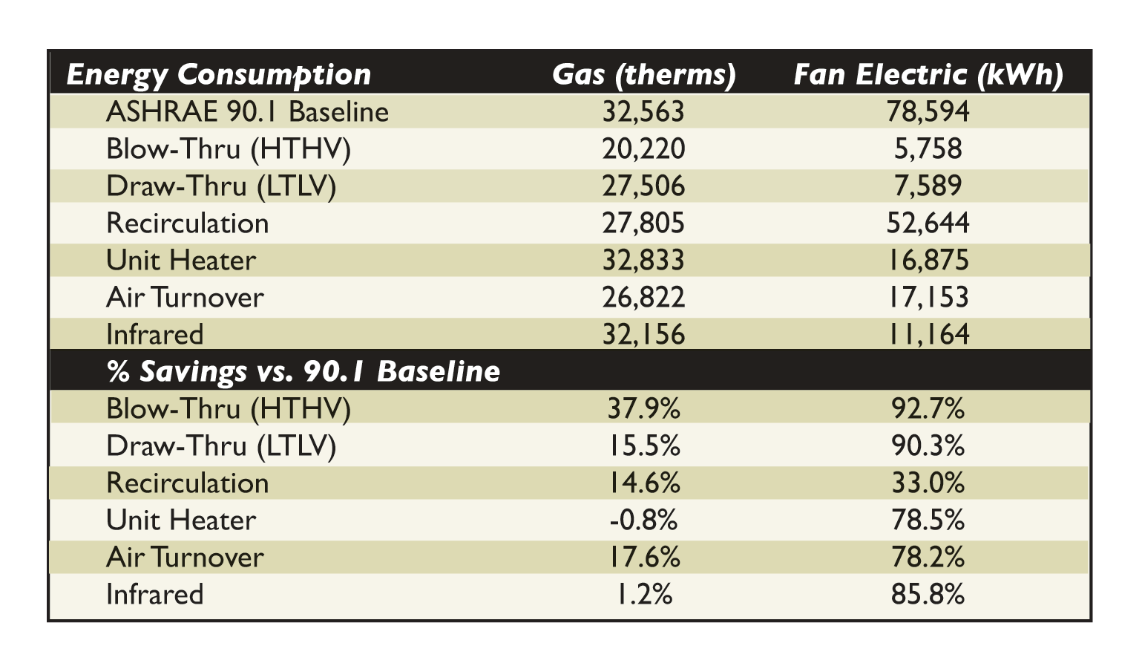
3rd Party Energy Modeling (EnergyPlus)
38% Gas Savings and 93% Electrical Savings over AHRAE 90.1 Energy Standard

Slide 45


Review: Key HTHV Education Statements
Energy Efficiency
Inherent Safety (IAQ)
Simplicity of Design

Slide 46
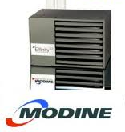
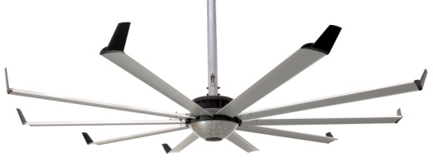
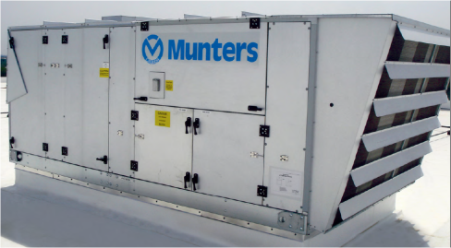
Massive Value for the Money
6 x High Efficiency
Unit Heaters
High Volume Low Speed (HVLS) Fans
1 X 1600 MBH (HTHV)
Heated Dedicated Outdoor Air Systems (DOAS)

Slide 47
Simplicity of Design
HTHV
  Single Piece of Equipment
  Single Electrical Connection
  Single Wall Penetration
  Zero Roof Penetrations
UH’s + HVLS + DOAS
  Multiple Pieces of Equipment
  Multiple Electrical Connections
  Multiple Flue Vents
  One Roof Curb
  Multiple Roof Penetrations
IMPROVES THE INTEGRITY OF THE BUILDING ENVELOPE

Slide 48
Key Take-Aways
Widespread use of 100% Outside Air, Direct Fired MAU
  HTHV Applications (Heating & Ventilating)
  LTLV (Ventilating & Heating)
Inherently Safe Design –
  Ventilation is the Key
  Ventilation air & combustion air delivered by the same device
  Safety Codes
Energy Efficiency Explained (Thermodynamics Lesson)
  Cambridge Building Studies (40-70% Energy Savings)
  Gard Analytics Report (Energy Modeling HTHV)
  DOE Study – HTHV vs. Indirect Fired Unit Heaters
Lowest Total Installed Cost
  Simplicity of Design
  More Systems/Less Equipment
  Less Time & Materials
  Readiness at Install

Slide 49
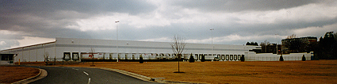
Suggested Next Steps
Site Visit - Join your Cambridge Engineering, Inc. representative at a local installation
Collaborate on a future project for Cambridge design recommendations
Review a past project for Cambridge design comparison value
Thrill your customers

Slide 50

Questions
Confidential – Cambridge Engineering

